Slide 1

SQL Server 2019
Always Encrypted:
The Searchable Encryption!
Mladen Prajdić, Data Platform MVP

Slide 2











Slide 3


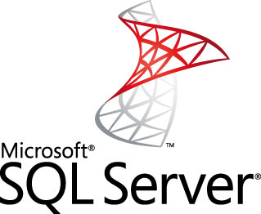

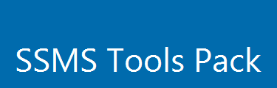
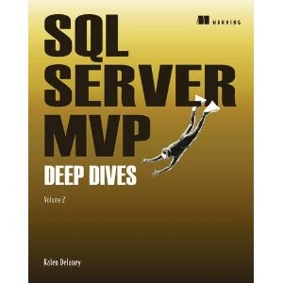
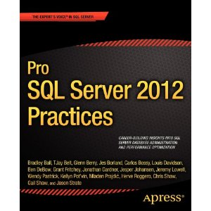
About me
Welcome to Slovenia
“Sunny side of Alps”

Slide 4
Cryptographic functions
Encryption
Symmetric - single key
DES, TripleDES, AES
Asymmetric - public key, secret key
Slower, used to exchange symmetric keys
Hashing
One way irreversible function
MD5, SHA1, SHA2, SHA3, ...
From SQL Server 2016, algorithms other than SHA2_256 & SHA2_512 are deprecated
HMAC
Hash based message authentication code
Verifies both message integrity and authentication
HMAC = H(key | H(key | ciphertext))

Slide 5
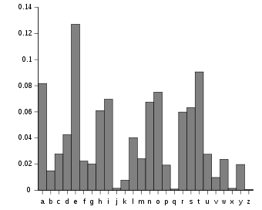
Deterministic encryption
Plaintext -> always same ciphertext
Can be indexed, joined, grouped, singleton look-up
Vulnerable to statistical frequency attacks
True/False, M/F, Countries, Territories, etc

Slide 6
Randomized encryption
Plaintext -> always different ciphertext
Looks statistically completely random
Can’t be practically reverse engineered
Public ciphertext and IV
No indexing, joins, grouping, etc

Slide 7
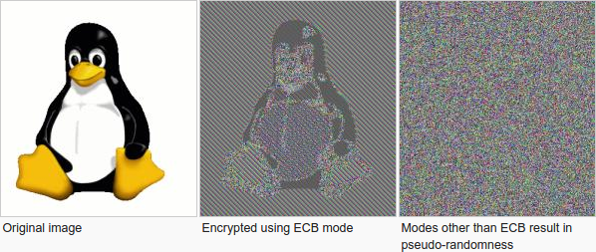
Deterministic vs Randomized Encryption

Slide 8
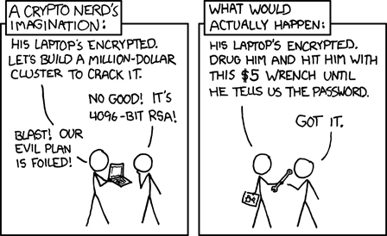
Pretty much how it goes ☺
https://xkcd.com/538/

Slide 9
Always Encrypted v1
Column Master Key, Column Encryption Key
Column-level encryption setting
Enabled via Connection String or in app
.Net 4.6
.Net 4.6.1 for custom keystore providers or bulk copy
AEAD_AES_256_CBC_HMAC_SHA_256
Authenticated Encryption scheme with Associated Data
Integrity and authentication (prevents value-substitution attacks)
Encrypt-then-MAC approach
Plaintext first encrypted, MAC produced from ciphertext
AES Cipher Block Chaining (CBC) to conceal patterns

Slide 10
What are value-substitution attacks?
ID | Title | Salary
352 | Junior DBA | Eht547%g4gs5e
624 | CFO | nklERG423yer4
529 | DBA | DDFges4891hTS

Slide 11
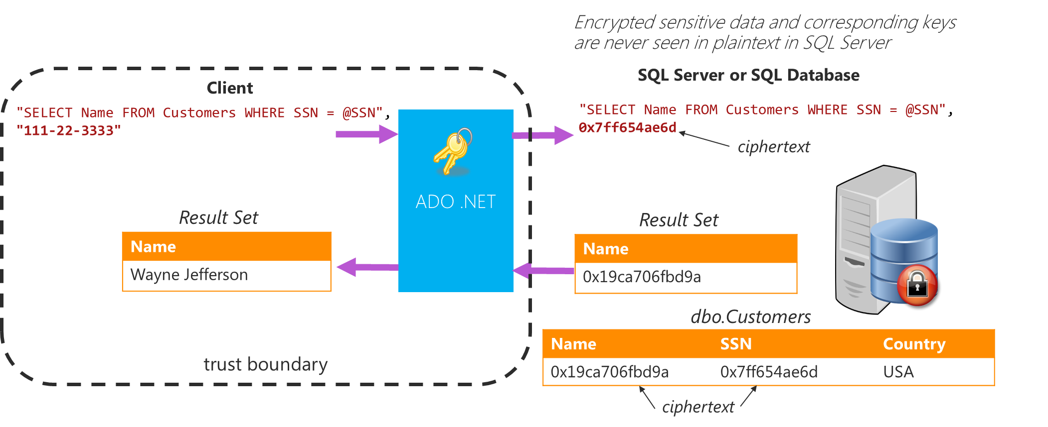
Always Encrypted v1

Slide 12
Always Encrypted v2
Enclave Enabled Column Master Key, Column Encryption Key
.Net 4.7.2
Custom keystore providers or bulk copy NOT supported yet
Must be configured with secure enclave provider
Takes care of enclave key exchange
Nuget
Enable in connection string or in app
Connection string attestation URL

Slide 13
Always Encrypted v2
In-place encryption
Initial encryption of column data
Re-encrypting column data
Rotating CEK (re-encrypting the column with a new key)
Changing encryption type
Decrypting data column data
All collations
Rich computations
BIN2 collation only
No indexes yet, Intel® Software Guard Extensions (SGX)

Slide 14
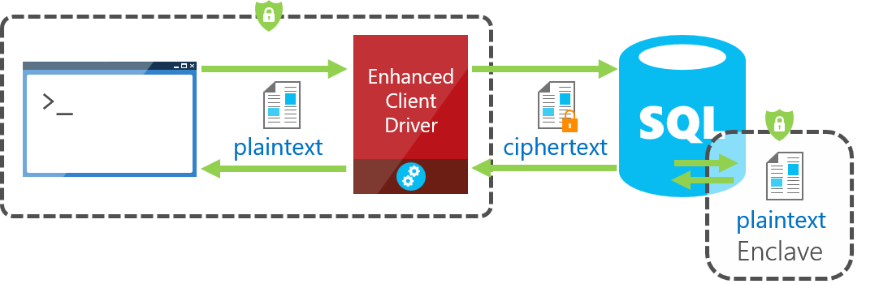
The new Always Encrypted!

Slide 15
Always Encrypted v2
Operation | Column is NOT enclave-enabled | Column is NOT enclave-enabled | Column is enclave-enabled | Column is enclave-enabled
 | Randomized encryption | Deterministic encryption | Randomized encryption | Deterministic encryption
In-place encryption |  |  | Supported | Supported
Equality comparison |  | Supported outside of the enclave | Supported (inside the enclave) | Supported outside of the enclave
Comparison operators beyond equality |  |  | Supported
LIKE |  |  | Supported

Slide 16
What’s this Secure Enclave you speak of?
Windows Server 2019 or Windows 10 version 1809
Virtualization-based Security (VBS)
Isolated region of memory within the address space of a user-mode process
Controlled by Windows hypervisor
Virtual Trust Levels, VTL0 and VTL1
Data only accessible by code running in the enclave
Code integrity
Loaded code is signed with a key
Restricted instruction set, but can do cryptographic computations
Azure confidential computing

Slide 17
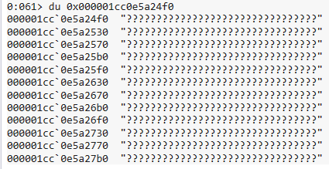
What’s this Secure Enclave you speak of?
Browsing a VBS enclave with WinDbg
Can be put into debug mode for testing but looses memory isolation

Slide 18
What’s this Secure Enclave you speak of?
Attestation
Proving the existence of something through evidence
Plaintext data, encryption keys, etc
Ensure they’re sent to intended enclave which must be trusted
Attestation report
Enclave mode, configuration, identity, inside code validity proof
Verified by trust relationship between report consumer and producer
Created within enclave
Signed by VBS unique key

Slide 19
Setting up Always Encrypted v2 - HGS
Windows Server 2019
Standard or Datacenter
Two CPUs, 8 GB RAM, 100 GB storage
HGS proves to the client
SQL Server VBS enclave in correct state
Can be trusted
Testing
Single physical machine or Gen 2 (UEFI Secure Boot support) VM
Azure now supports Gen 2 VM’s
Production
HA cluster of 3 physical machines is recommended

Slide 20
Setting up Always Encrypted v2 - HGS
Creates separate Active Directory forest
NOT joined to your enterprise domain
Separate administration
Security responsibility separation for the HGS
HTTP and HTTPS attestation
SSL cert has to be trusted on SQL Server and client machines
Allow access through firewall to only
SQL Server
Client computers (web servers)

Slide 21
Setting up Always Encrypted v2 - HGS
Host key attestation
SQL Server machine issues a public/private key pair certificate
Public key manually copied to HGS and registered as valid SQL Server
Register the URL location of HGS on SQL Server
Will NOT verify software or firmware running on the SQL Servers
Use for testing only!

Slide 22
Setting up Always Encrypted v2 - HGS
Trusted Platform Module (TPM) attestation
Validates SQL Server hardware to make sure it
Runs only correct binaries and security policies using the unique ID
Running trustworthy kernel and user mode code
Create code integrity policy on SQL Server machine
Restricts which software can run on the system
Collect SQL Server machine TPM identifier and baseline
Copy to HGS and register for attestation
Use for production

Slide 23
Setting up Always Encrypted v2 – SQL
Win 10 Enterprise version 1809 or Win Server 2019 Datacenter
SQL Server 2019 preview or newer
SSMS 18 or above
If physical
64-bit CPU with Second Level Address Translation (SLAT)
CPU support for VM Monitor Mode Extension (VT-c on Intel CPUs)
Virtualization support enabled (Intel VT-x or AMD-V)
If virtual
Hyper-V 2016+ with Enabled nested virtualization extensions on VM CPU
VMWare vSphere 6.7 with Enabled Virtualization Based Security

Slide 24
Setting up Always Encrypted v2 – SQL
Set up SQL Server to use VBS
Confirm VBS loaded ok, both value columns must return 1
EXEC sys.sp_configure 'column encryption enclave type', 1;
RECONFIGURE;
SELECT [name], [value], [value_in_use]
FROM sys.configurations
WHERE [name] = 'column encryption enclave type';

Slide 25
Setting up Always Encrypted v2 – SQL
Create and populate test table
CREATE TABLE [dbo].[Employees]
(
[EmployeeID] [int] IDENTITY(1,1) NOT NULL,
[SSN] [char](11) NOT NULL,
[FirstName] [nvarchar](50) NOT NULL,
[LastName] [nvarchar](50) NOT NULL,
[Salary] [money] NOT NULL
) ON [PRIMARY];
INSERT INTO [dbo].[Employees] ([SSN] ,[FirstName] ,[LastName] ,[Salary])
VALUES ('795-73-9838' , N'Catherine' , N'Abel' , $31692);
INSERT INTO [dbo].[Employees] ([SSN] ,[FirstName] ,[LastName] ,[Salary])
VALUES ('990-00-6818' , N'Kim' , N'Abercrombie' , $55415);

Slide 26
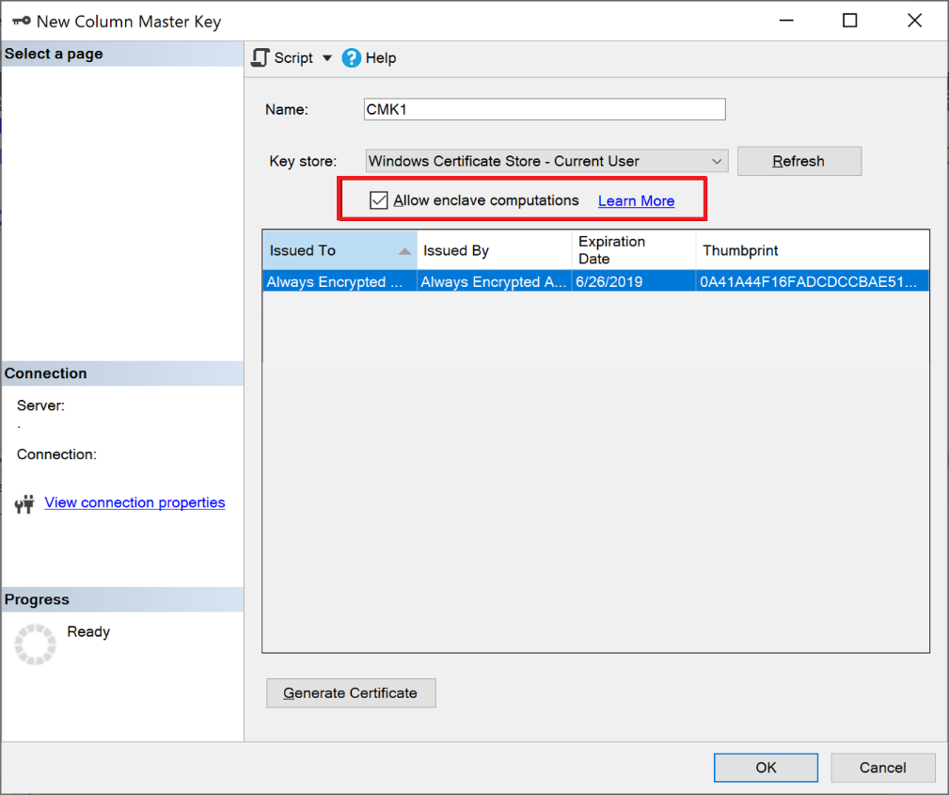
Setting up Always Encrypted v2 – SQL
Provision enclave enabled Column Master Key
SSMS or Powershell
ENCLAVE_COMPUTATIONS
Set and signed
Client driver verifies signature before use
Read only
CMK key rotation

Slide 27
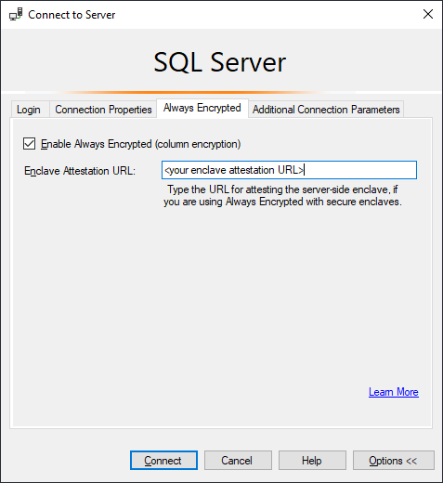
Setting up Always Encrypted v2 – SQL
Enable Always Encrypted with secure enclaves in SSMS connection dialog
If no Attestation URL entered then it’s Always Encrypted v1

Slide 28
Setting up Always Encrypted v2 – SQL
Do in-place encryption
ALTER TABLE [dbo].[Employees]
ALTER COLUMN [Salary] [money]
ENCRYPTED WITH (
COLUMN_ENCRYPTION_KEY = [CEK1],
ENCRYPTION_TYPE = Randomized,
ALGORITHM = 'AEAD_AES_256_CBC_HMAC_SHA_256') NOT NULL
WITH (ONLINE = ON);
ALTER TABLE [dbo].[Employees]
ALTER COLUMN [SSN] [char] (11) COLLATE Latin1_General_BIN2
ENCRYPTED WITH (
COLUMN_ENCRYPTION_KEY = [CEK1],
ENCRYPTION_TYPE = Randomized,
ALGORITHM = 'AEAD_AES_256_CBC_HMAC_SHA_256') NOT NULL
WITH (ONLINE = ON);

Slide 29
Setting up Always Encrypted v2 – SQL
Do rich computations, pattern matching
-- enable rich computations
DBCC traceon(127,-1)
GO
-- do rich computations
DECLARE @SSNPattern [char](11) = '%6818';
DECLARE @MinSalary [money] = $1000;
SELECT *
FROM [dbo].[Employees]
WHERE [SSN] LIKE @SSNPattern AND
[Salary] >= @MinSalary;

Slide 30
Setting up Always Encrypted v2 – .Net
Configure secure enclave provider found on Nuget
<SqlColumnEncryptionEnclaveProviders>
<providers>
<add name="VBS"
type="Microsoft.SqlServer.Management
.AlwaysEncrypted.EnclaveProviders
.VirtualizationBasedSecurityEnclaveProvider, Microsoft.SqlServer.Management.AlwaysEncrypted.EnclaveProviders,
Version=15.0.0.0, Culture=neutral, PublicKeyToken=89845dcd8080cc91"/>
</providers>
</SqlColumnEncryptionEnclaveProviders>

Slide 31
Setting up Always Encrypted v2 – .Net
Configure connection string
<add
name="DefaultConnection"
connectionString="Data Source = ServerName;
Initial Catalog = YourDb; Integrated Security = true;
Column Encryption Setting = Enabled;
Enclave Attestation Url = https://FullDomainNameOfHGS/Attestation"
providerName="System.Data.SqlClient"/>

Slide 32
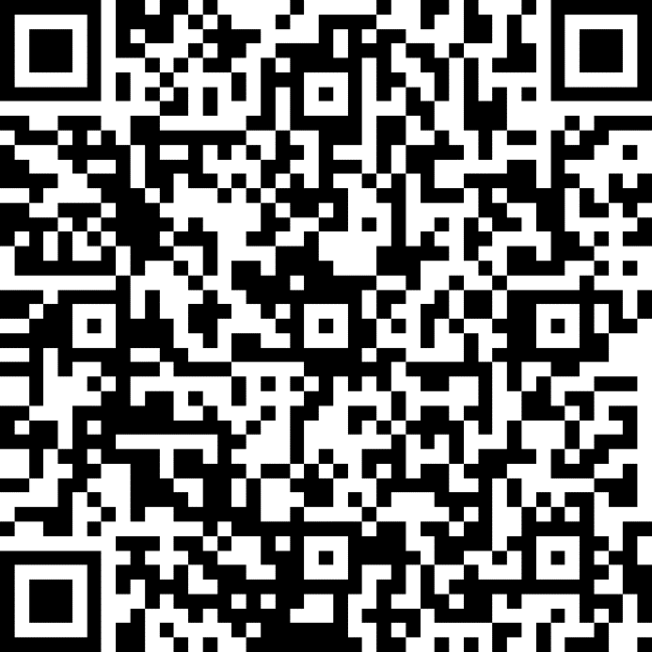
Session Feedback Day 2
http://bit.ly/DataGrillen2019Day2

Slide 33
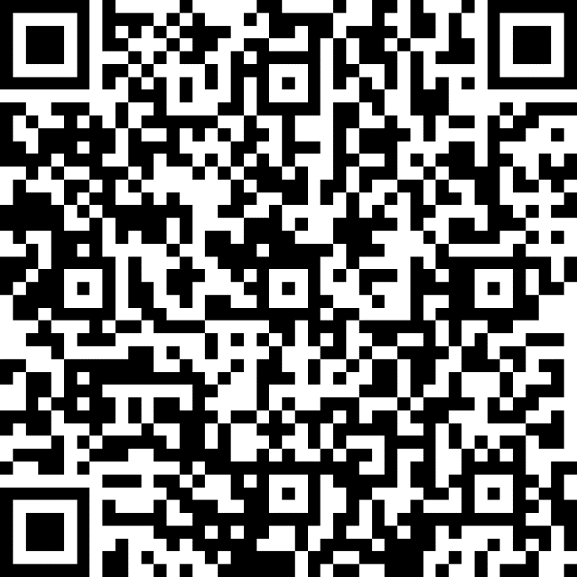
Event Feedback
http://bit.ly/DataGrillen2019Event

Slide 34
?

